Slide 1
Superhero Analysis
March 2019

Slide 2

What makes a person with superpower strong?
CSV from Kaggle
Clean Data in pgAdmin SQL
Put Data into Jupyter
DataFrame Tables
Joint/Filter in Jupyter
Analysis

Slide 3
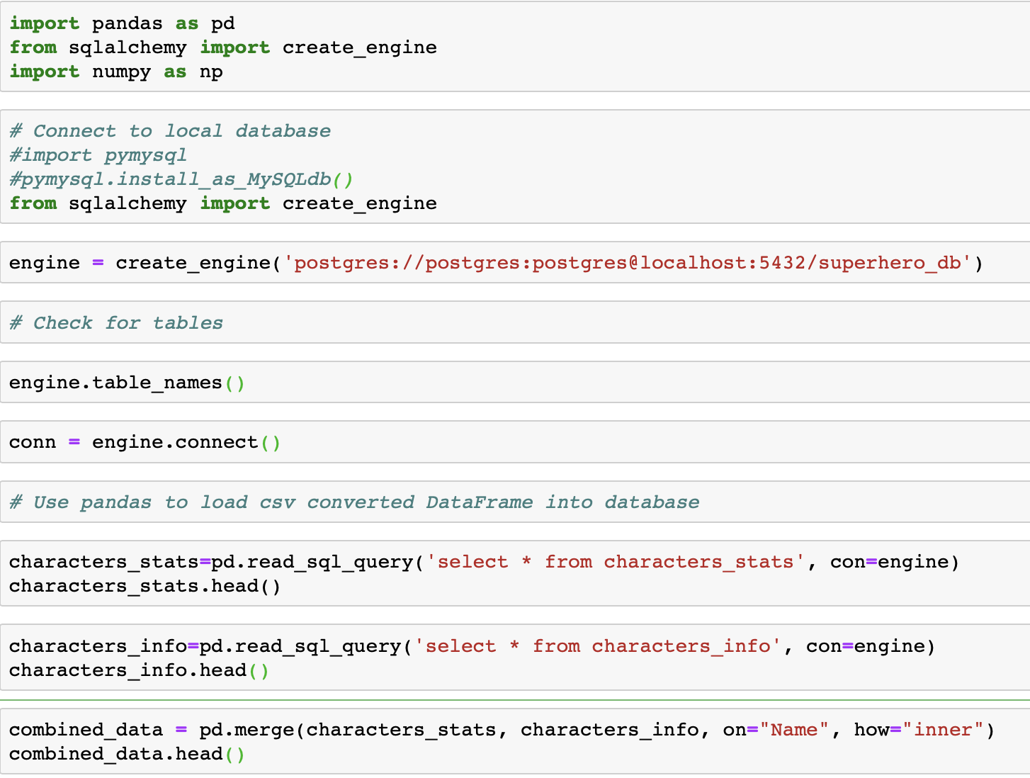
Setting Up/ Joining Tables

Slide 4
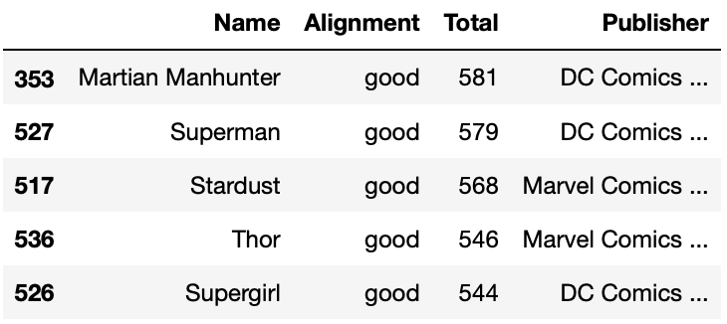
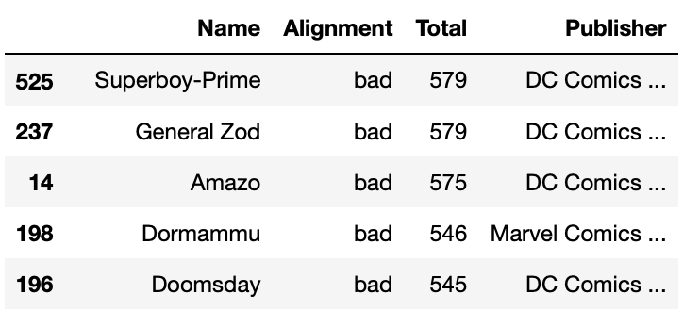
Top 5 - The Most Powerful Hero and Villain

Slide 5
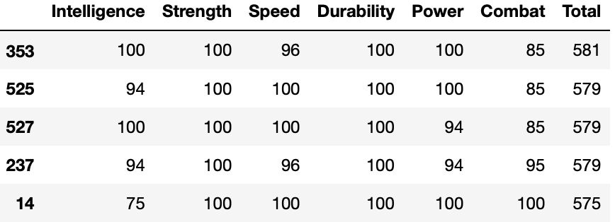
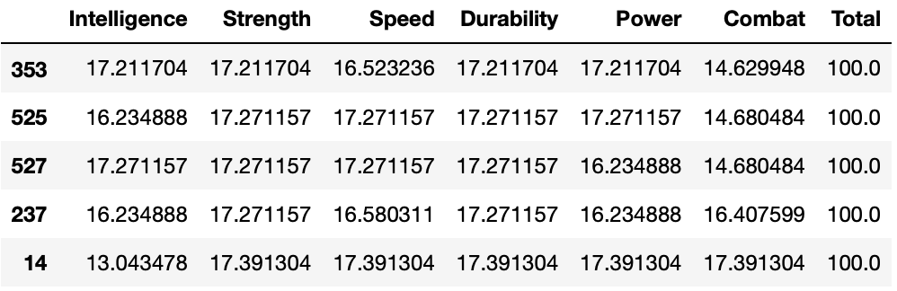

How are their trait contributions?

Slide 6

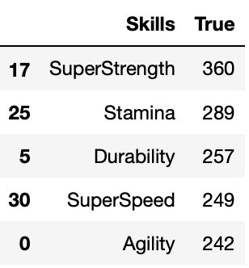
What Are The Top Skills Superheroes Or Villains Have?

Slide 7
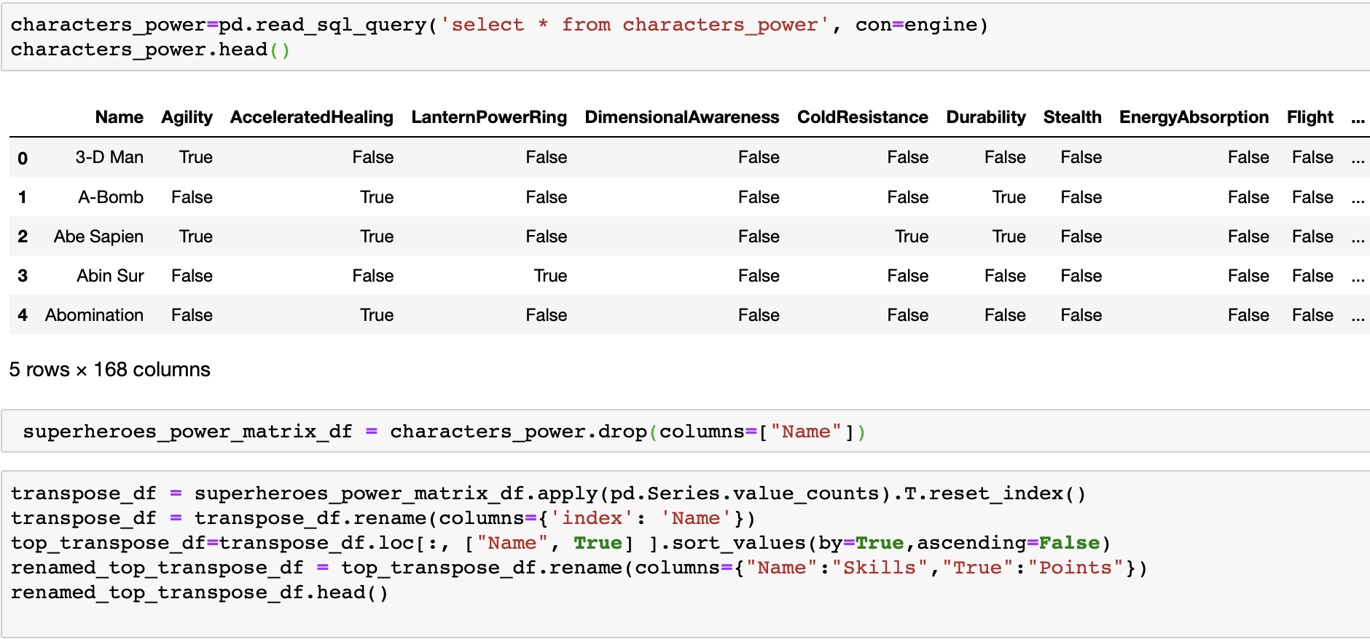
HOW?

